Slide 1
Let’s put puzzle parts together

Slide 2

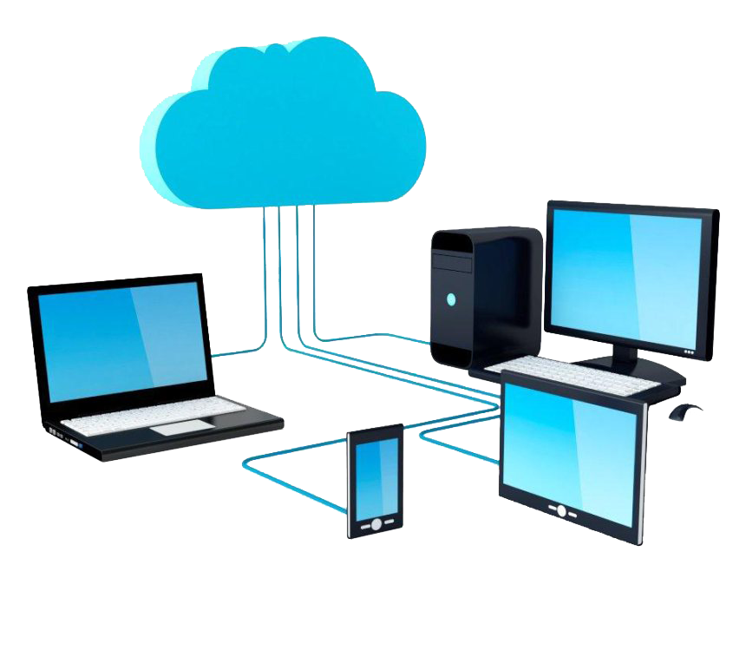
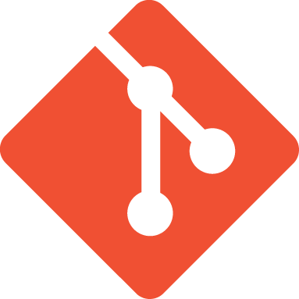

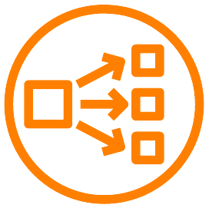
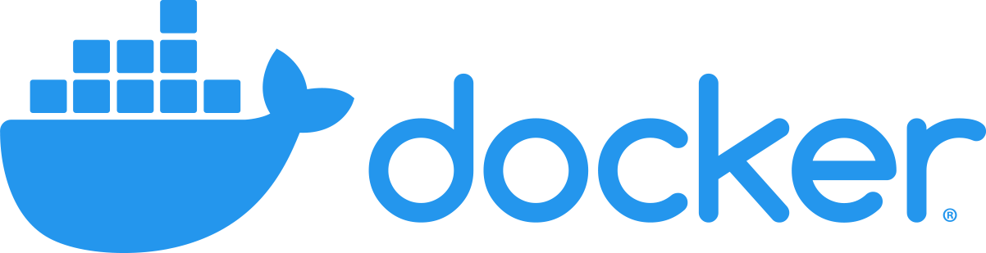
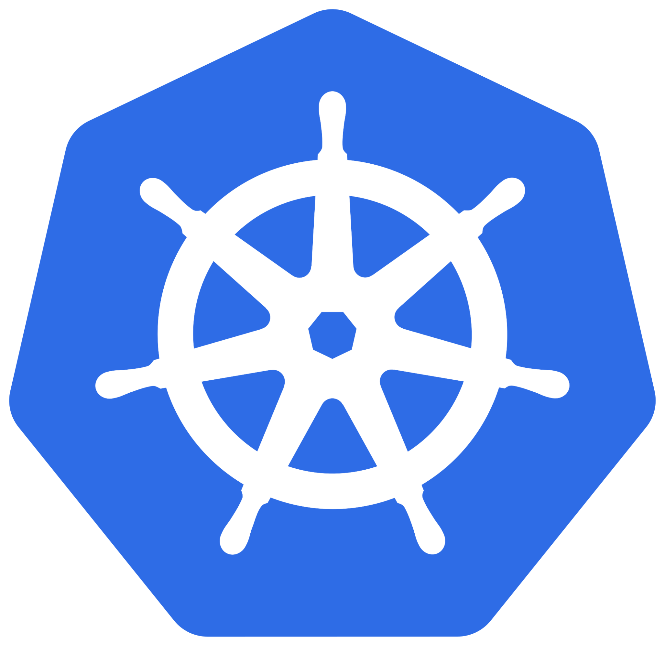

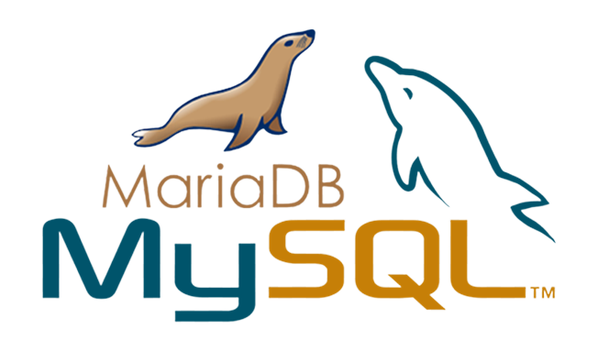
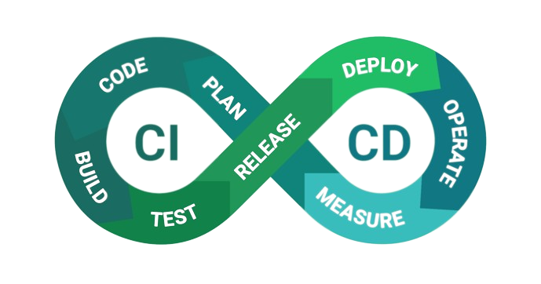



What we talked about?
Network
Virtualization
Alphabet
Container
SQL & noSQL
Reverse Proxy
Container Orchestration
App
App
Base
OS
OS
Version Control
Hardware
Hardware
Hypervisor
CI/CD
OS
Visibility
Hardware
Bonus

Slide 3
Capstone Project
Kubernetes
Git & Image registry
Build & Deploy
Reverse Proxy

Slide 4
Capstone Project
A single node node cluster is OK as long as it has sufficient resources but remember that this is not a production level cluster.
We need at least 2 namespaces:
One for our application
One for CI/CD worker
Kubernetes

Slide 5
Capstone Project
We need 2 functionalities here:
A version control which I recommend using Gitlab (community edition)
A docker registry for our images which Gitlab can provide it too. If you want, you can use any other services like Nexus.
Beware that you can use this as your CI (or even CD for our use case) which we will talk about later
Create one repository to store any K8S’s manifests
Create another one to store your application code
If you want, you can use any application that you want but to keep it simple, you can create a simple Nginx configuration with a simple html file.
Don’t forget to dockerize it by placing a “Dockerfile” in your repository which will package your application.
Git & Image registry

Slide 6
Capstone Project
We need any CI/CD tool. You can use gitlab-ci alongside ArgoCD which is perfect or Jenkins. As long as CI is separated from CD, it doesn’t matter which tool(s) you use.
We’re not going to implement the complete CI/CD and we simply it to only build (from CI) and deploy (from CD) which is perfect for a junior DevOps.
For build pipeline, clone into your repository on Gitlab and build it via its Dockerfile and push the image to your registry.
For Deploy pipeline, clone into the specific repository which holds your K8S’s manifests for your app and update, apply them (you can merge these two repositories as well if you want)
Connect you CI/CD tool to K8S to use a specific namespace for its workers which will run our pipelines.
Build & Deploy

Slide 7
Capstone Project
Bonus:
Trigger CI from your version control by a merge event to master/main branch
Trigger CD if CI was successful (This is not recommended on production with current CI/CD which leveled down to only build and deploy but it’s OK for development environments)
Build & Deploy

Slide 8
Capstone Project
Setup a HAproxy or Nginx which will handle all of your incoming traffics, including your own tools and your application on K8S.
Considering your domain is: “cafetechnical.com”:
Serve your application on K8S through:
app.cafetechnical.com
Serve your Gitlab through:
gitlab.cafetechnical.com
Serve your Image registry through:
registry.cafetechnical.com
…
NOTE: do not mix this reverse proxy with the load balancer which you need for K8S.
Reverse Proxy

Slide 9
Capstone Project: Extra
You can setup a Prometheus server as well
Use “node exporter” to grab OS related metrics
Use “cadvisor” to grab container related metrics
Use “kube-state-metrics” for K8S related metrics
Configure your prometheus to scrape from these exporters to hold on their exposed metrics.
You can setup an Elasticsearch as well
Use fluentd or fluentbit or filebit to read any log file as you want and send them to your Elasticsearch server
These are a little tricky since you need to handle something that you may never worked with before but there are a lot of references which help you to setup this. This is essential for your career to be able to handle such situations.

